Slide 1
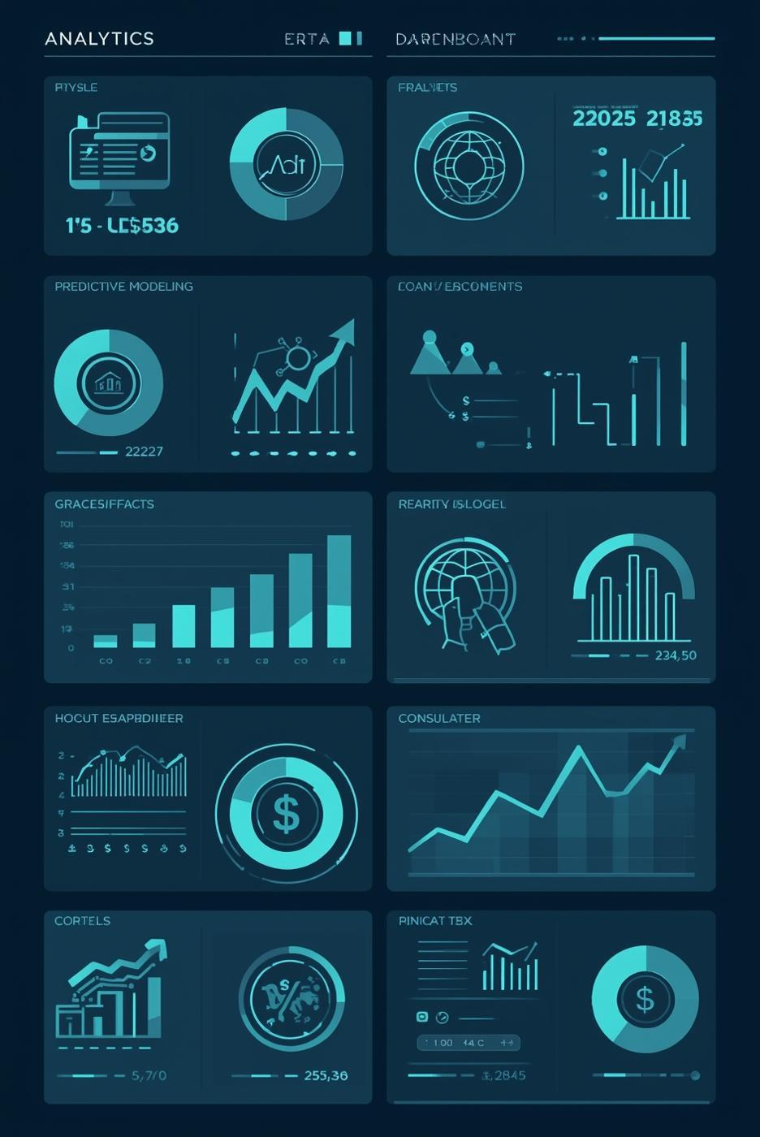
Home Credit Default Risk
IS 6812 Presentation
Amiya Ranjan Sahoo Gaurav Mishra
Jeffrey Zhang Rob Sheehy

Slide 2

The Business Problem
Lenders often can’t easily identify default applicants
Misclassifying risky borrowers leads to avoidable financial losses
HC needs a reliable way to predict default risk before approving loans

Slide 3

What We Built
Predicts probability of default
Approve / Review / Decline
Lower losses & improves approvals

Slide 4
Key Business Results
Metric | Value
Default Rate Reduced | 8.1% → 2.9%
Defaults Prevented | 4,807 annually
Annual Savings | $38.5 M
Loss Reduction | 65%
Before vs. After (Model Impact)
Baseline (Before Model)
Default rate: 8.1%
Annual defaults: 7,447
With Model (After Implementation)
Default rate: 2.9%
Annual defaults: 2,640

Slide 5
Input Data
Risk Model
Decision Action
Applicant demographics
Financial + Credit History
Payment behavior
Calculates a risk score (0-1)
Higher score = higher risk
Low score → Approve
Medium score → Review
High score → Decline

Slide 6
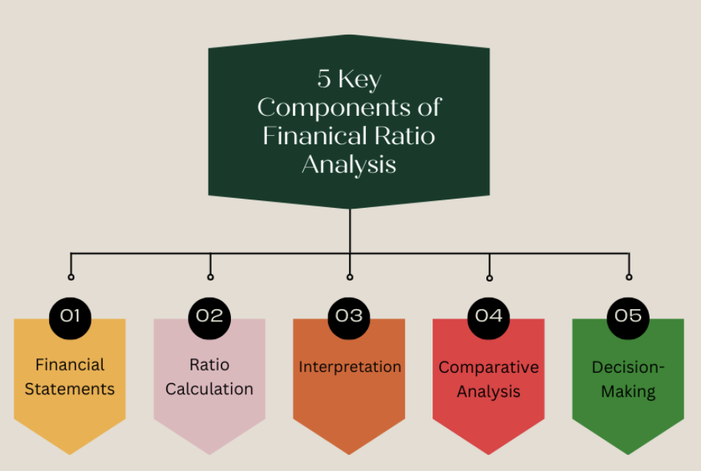
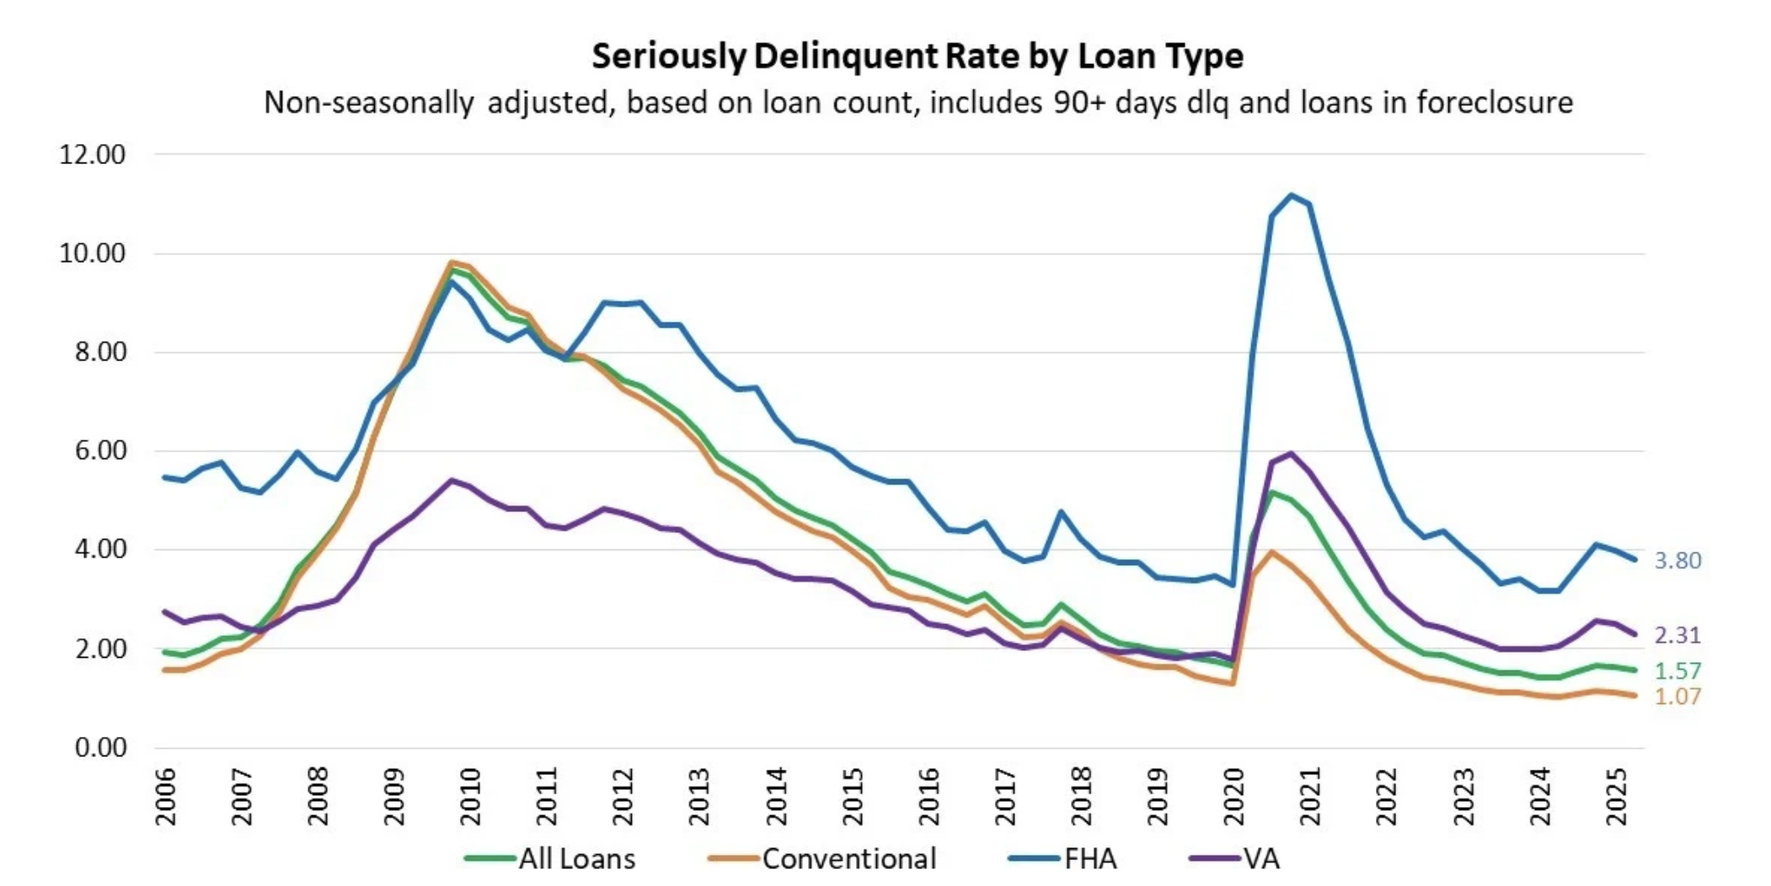

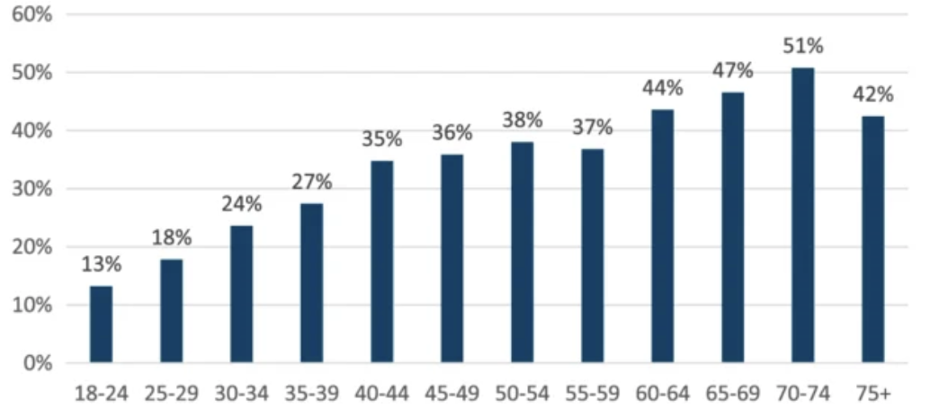


Key Drivers
Ratio
History
Length
Age
Measures financial health effectively
Past delinquencies indicate risk
Longer employment suggests stability
Age influences financial responsibility

Slide 7

Meet Jane - Sample Applicant
Meet Jane
Risk Score: 0.12 → APPROVE
Why the model approves her:
Stable employment (8+ years)
Low debt-to-income ratio
No previous late payments
Sufficient savings & verified income
“Jane is a 35-year-old retail manager applying for a $50,000 loan. She has steady income, a strong payment history, and no delinquencies”

Slide 8

Data Prep - Feature Engineering
Converted days → years Makes age/employment intuitive and more predictive.
Created financial ratios Improves ability to detect repayment capacity.
Aggregated bureau history Captures long-term credit behavior instead of one-off signals.
Applied class weighting (11× defaults) Prevents the model from ignoring the minority class (defaulters).
Outcome: Improved model separation between good vs. bad borrowers (higher AUC / better lift)

Slide 9
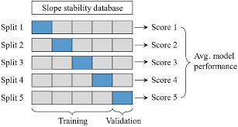
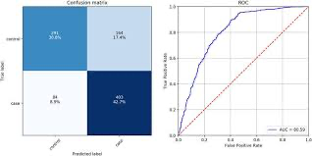
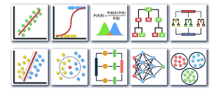
Modeling Approach: Optimizing Predictive Accuracy
Four models were rigorously tested
Employed 5-fold cross-validation technique
AUC metric to evaluate performance

Slide 10
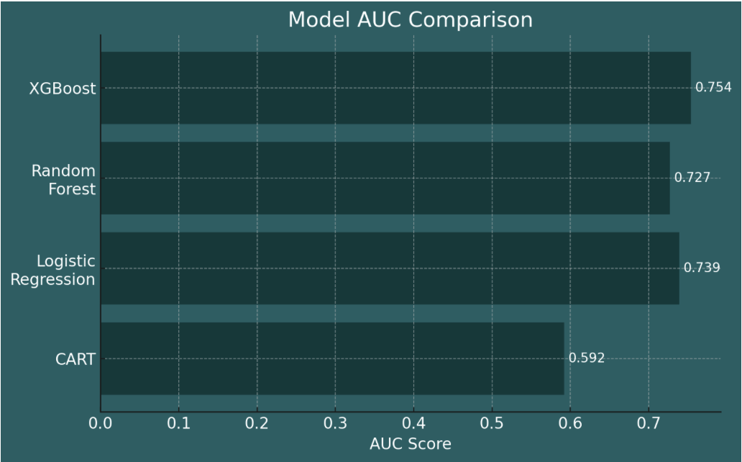
Model Performance Comparison
XGBoost delivered the strongest performance with an AUC of about 0.75.
Logistic regression and Random Forest followed closely, showing solid and consistent results.
The decision tree model trailed behind, which is expected for a single-tree approach on complex data.
AUC measures how well the model separates defaulters vs. non-defaulters

Slide 11
XGBoost
Best-performing model in our experiment
Catches more true defaults while keeping errors balanced
Consistent performance on both training and validation
Captures complex patterns the other models miss
Metric | Values
Cross-validated AUC | ≈ 0.754
Validation AUC | ≈ 0.753
Best Settings | Depth = 6, Rounds = 400, η = 0.05

Slide 12
Implementation and Integration of the Model
Real-time Deployment
API scoring integrated into loan application workflow.
Scores returned instantly for underwriting.
Decision Thresholds
Pre-defined cutoffs for Approve / Review / Decline.
Aligned with business risk appetite.
Human Oversight
Manual review for borderline or high-risk applicants.
Ensures compliance and ethical standards.
Annual model retraining or earlier if drift detected.

Slide 13
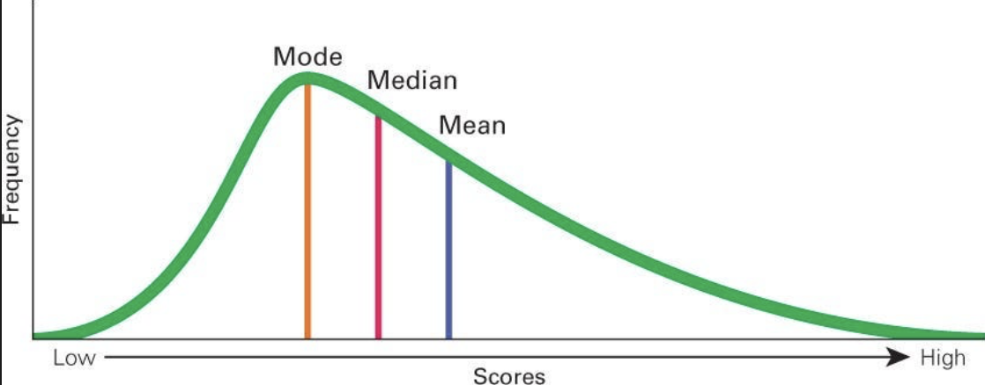
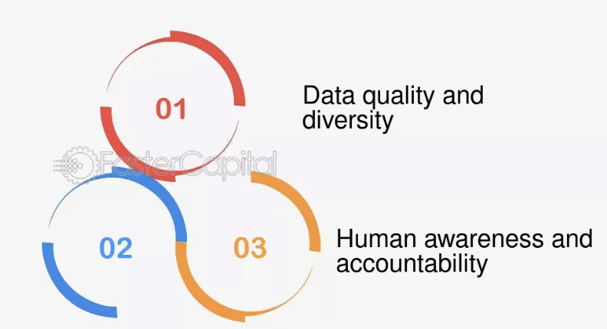
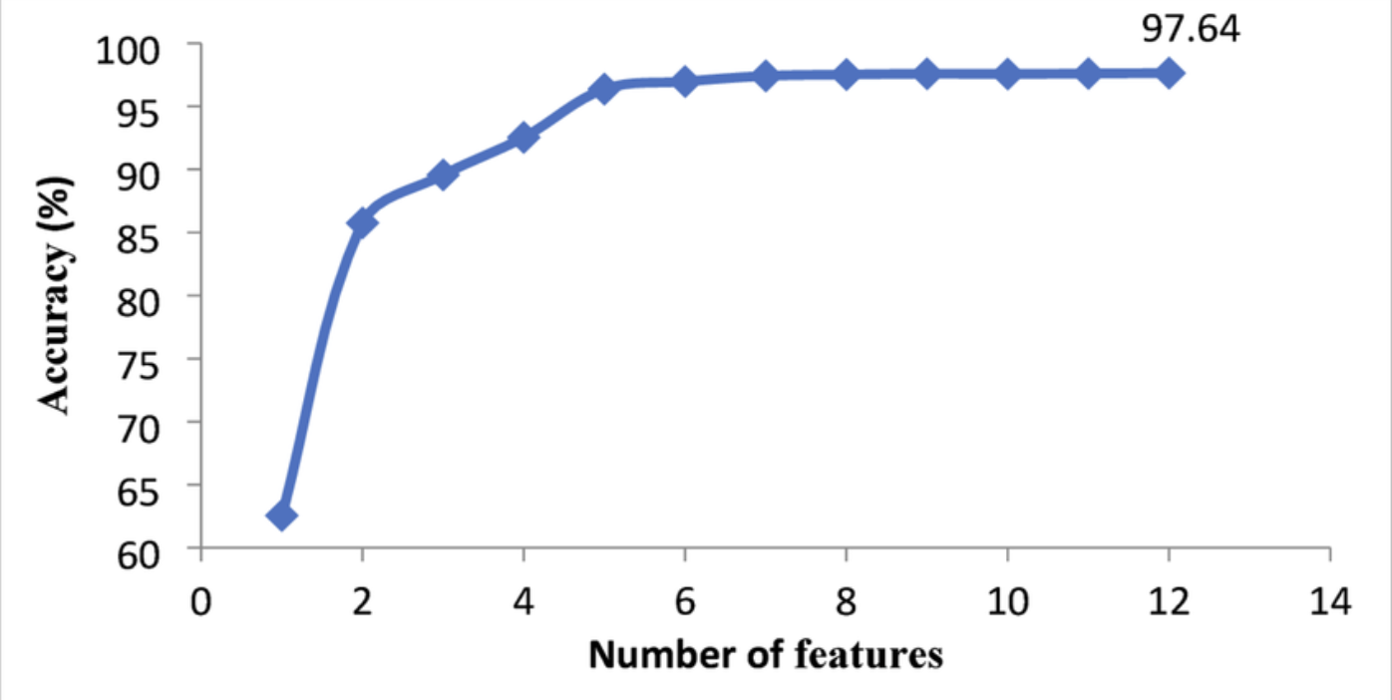

Addressing Model Limitations and Future Considerations
Missing data can skew results
Potential biases affect fairness
Additional features enhance accuracy

Slide 14
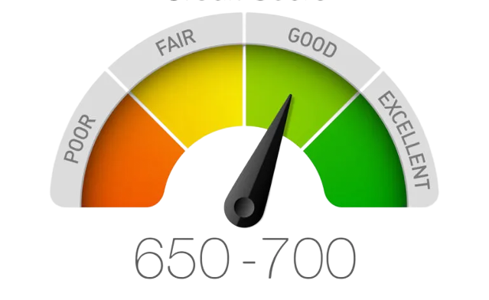
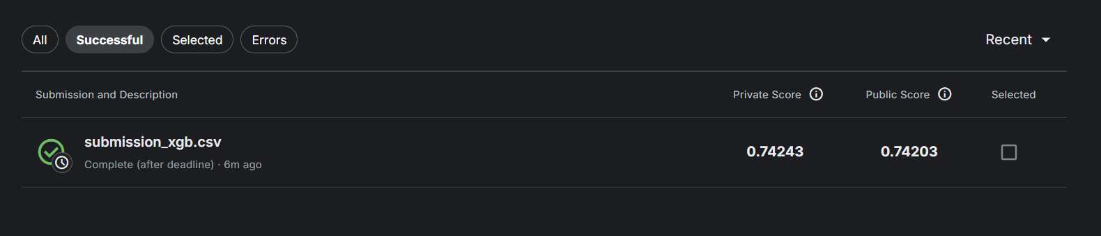
Kaggle Score

Slide 15


